Slide 1
BELL Learning project

Slide 2

Welcome
We are Team BELL:
Rebecca Sewell
Esther Makinde
Linsay O’Hare
Louise Anderson
(Honorary member: Jpeg ‘Peggy’ the kitten)
<number>

Slide 3
1
CFG Software Engineering
Group project - Revision App

Slide 4
We felt students would benefit from a revision app to solidify new programming language concepts
<number>

Slide 5
Key features
Accessible design: User-friendly colour scheme
Progress tracker
In-house content and database creation
Bootstrap Stack
<number>

Slide 6
Demo to audience
<number>

Slide 7
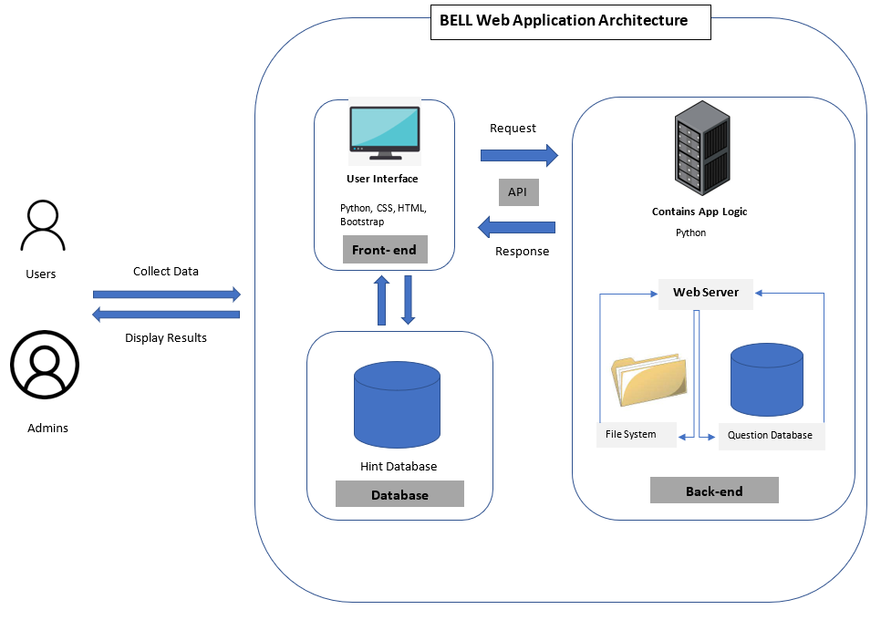
Architecture diagram:
<number>

Slide 8
Roadmap
Group Formation
Ambition
Troubleshooting
1
3
5
2
4
6
Ideas
Creation
Execution of idea
<number>

Slide 9
Thank you!
Project Github: https://github.com/ginkoding/CFG-Revision-App-Group-2
<number>

